Slide 1


EMPLOYEE LEAVE MANAGEMENT SYSTEM

Slide 2
Problem Statement
Manual leave tracking is inefficient and error-prone, leading to inaccurate records and wasted administrative time. Managing employee leave records becomes increasingly difficult as the organization grows.
There is a lack of transparency between employees and management regarding leave balances and request status. The approval process is time-consuming, causing delays and frustration for all stakeholders.

Slide 3



Objectives
Automate leave application and approval process, eliminating manual paperwork and streamlining workflow for faster processing times.
Maintain centralized employee leave records with real-time status updates, ensuring transparency between employees and management.
Reduce human errors and administrative overhead through automated calculations and digital record-keeping systems.

Slide 4
System Overview
Employee Applies for Leave
Employee submits leave request through the system portal, selecting dates .
System Updates Balance
Upon approval, the system automatically calculates and updates the employee's leave balance.
Manager Reviews & Approves
Manager receives leave request notification and reviews details. Can approve or reject with comments.
Admin Monitors Records
Administrator has full visibility of all leave records, can generate reports and manage system settings.

Slide 5
System Workflow
Steps 1-3: The workflow begins when an Employee or Admin logs into the system using secure authentication. Once logged in, the employee submits a leave application by selecting dates, and providing a reason. The system then automatically validates the request against the employee's available leave balance.
Steps 4-6: After validation, the leave request is routed to the designated Manager for approval or rejection. Upon decision, the system automatically updates the employee's leave records and balance. Finally, the employee see the status of their leave request.

Slide 6



Technology Stack
Frontend: HTML, CSS, JSP for responsive and interactive user interface design with modern web standards.
Backend: Java (Servlets/JSP) for server-side logic and business process handling.
Database: MySQL for reliable data storage with MVC (Model-View-Controller) architecture pattern.

Slide 7
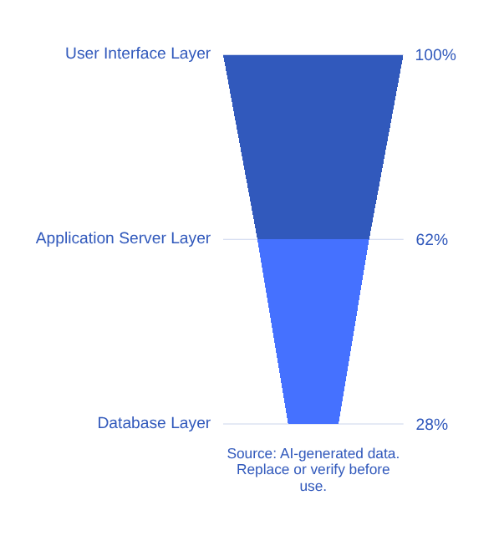
Architecture Diagram
The system follows the MVC (Model-View-Controller) architecture pattern, ensuring clear separation of concerns:
• User Interface Layer: Handles all user interactions and displays
• Application Server Layer: Processes business logic and requests
• Database Layer: Stores and manages all system data
Interaction Flow: User → Server → Database

Slide 8
Core Features
Employee login system with secure authentication
Leave request submission with flexible date selection
Real-time leave balance tracking and display
Manager approval/rejection workflow system
Comprehensive admin dashboard for monitoring all records
When manager approval/rejection leave status updates.

Slide 9
Database Design
Employee Table
• Employee ID (Primary Key)
• Name, Email, Department
•Role
(Manager/Admin)
Leave Requests Table
• Request ID (Primary Key)
• Employee ID (Foreign Key)
• Start/End Date
• Status, Reason
Leave Balance Table
• Employee ID (Foreign Key)
• Total Days, Used Days
• Remaining Days
Relationships
• Employee ID links all three tables
• One-to-Many: Employee → Requests
• One-to-Many: Employee → Balance

Slide 10
Advantages
Saves time by automating manual processes and improves accuracy by eliminating calculation errors in leave tracking.
Easy tracking of leave history and patterns enables better communication between employees and management.
Centralized data access allows quick decision-making and provides transparency across the organization.

Slide 11
Limitations
Requires internet connection or system access for full functionality
Basic security implementation may need enhancement for sensitive environments
Dependent on user training for proper adoption and effective use
Initial setup and data migration required before deployment

Slide 12
Future Scope
Mobile app integration enables on-the-go leave management access. Email and SMS notifications provide real-time updates on application status. AI-based prediction analyzes leave patterns to help managers plan workforce availability more effectively.
Biometric integration enhances security through fingerprint or facial recognition authentication. Seamless payroll system integration ensures accurate salary calculations based on leave records. Multi-language support expands accessibility for diverse workforces.

Slide 13
Conclusion
The Employee Leave Management System automates leave management, reducing manual inefficiencies and enhancing productivity across the organization.
It provides a centralized platform for employees and managers, ensuring transparency, accuracy, and faster leave processing for all stakeholders.
This solution modernizes traditional leave management, creating a more efficient and streamlined workplace environment.

Slide 14

THANK YOU FOR YOUR ATTENTION
Questions and Feedback Welcome

